Slide 1
What does infectious disease look like in the mind?
Nick Michalak
Josh Ackerman
Notes:
Hi, thank you. Today I’m going to be talking about mental representations of infectious disease.
Wikipedia: A mental representation (or cognitive representation), in philosophy of mind, cognitive psychology, neuroscience, and cognitive science, is a hypothetical internal cognitive symbol that represents external reality or else a mental process that makes use of such a symbol: "a formal system for making explicit certain entities or types of information, together with a specification of how the system does this.”
Webster: a disease caused by the entrance into the body of organisms (as bacteria, protozoans, fungi, or viruses) which grow and multiply there

Slide 2
Think of an INFECTED person
Notes:
To get a feel for what I mean, I’d like you take a moment to think of an infected person. Think about this person's most obvious facial features.
I encourage you to keep this image in mind throughout my talk because that's the centerpiece of this research.
Where does representation come from? What does it look like? What does is do for us?

Slide 3
Perceptual and cognitive systems are “designed” by natural selection to address recurring, fundamental challenges
Gibson,1979; McArthur & Baron,1983; Neuberg & Schaller, 2014
Notes:
To start, I assume that mental representations come from perceptual and cognitive systems designed to address fundamental threats.

Slide 4
Infectious disease is an enduring, predictable feature of the environment.
Murray & Schaller, 2015
Notes:
Infectious disease caused by viruses, bacteria, and fungi is just one of many enduring features of the environment that has imposed an immense selection pressure on the evolution of life for millions (if not billions) of years (Tollrian & Harvell, 1999).

Slide 5
Biological systems are “designed” to detect and reduce pathogen threats.
Nesse, 2005; Murray & Schaller, 2015
Notes:
As a consequence, a variety of species, from bacteria and insects to birds and mammals, have developed an arsenal of physiological and behavioral strategies equipped to avoid, control, or eliminate harmful parasites.

Slide 6
Social creatures use cues to infer pathogen infection in members of their own species.
Behringer, Butler, & Shields, 2006; Curtis, 2014; Klein, Gamble, Nelson, 1999; Krause, & Godin, 1994
Notes:
Social creatures rely on perceivable cues in members of their own species to infer pathogen infection.

Slide 7
People have a highly-developed visual skill for face perception.
Bentin, Allison, Puce, Perez, & McCarthy, 1996; Birmingham, Bischof, & Kingstone, 2009; Haxby, Hoffman, & Gobbini, 2000; Kanwisher, McDermott, & Chun, 1997
Notes:
With respect to humans, people probably rely a lot on visual cues, especially facial cues.

Slide 8
Mumps
Measles
23/25 (92%) of most deadly infectious diseases cause symptoms visible in the face.
Ryan, Oaten, Stevenson, & Case, 2012; Wolfe, Panosian, & Diamond, 2007
Yellow Fever
Notes:
And facial cues happen to be a great source of information because many of the most deadly diseases cause symptoms that can be seen on the face.

Slide 9
Symptoms of infectious disease vary a lot across diseases and individuals: perceivers can’t be accurate
Haselton & Nettle, 2006; Murray & Schaller, 2015
Notes:
But there are probably too many symptoms for a mental system to keep track of and identify accurately

Slide 10
Obesity Park, Schaller, & Crandall, 2007
Facial disfigurement Ryan, Oaten, Stevenson, & Case, 2012
People respond to anomalous facial features as if these features cue infectious disease
Old age Duncan & Schaller, 2009
Murray & Schaller, 2015
Notes:
So people probably play it safe and overgeneralize; they assume that any nonnormative physical feature could be a sign of infectious disease

Slide 11
Mental representations of faces share processes with direct facial perception.
Birmingham, Bischof, & Kingstone, 2009; Ishai, Haxby, & Ungerleider, 2002; Mechelli, Price, Friston, & Ishai, 2004; O’Craven & Kanwisher, 2000
Notes:
And some evidence suggests that mental representations of faces share processes with direct facial perception.
So it could be that the same features we use to detect pathogen threats might show up in our mental representations.
But they don't have to.

Slide 12
Research questions
What does an infected person look like in people’s minds? Generally negative? Does this person show heuristic cues to infection?
Are these features more extreme for people who feel more vulnerable to pathogen threats?
Do these images motivate people to avoid perceived pathogen threats?
Notes:
It's a testable question. This brings me to our research questions.

Slide 13
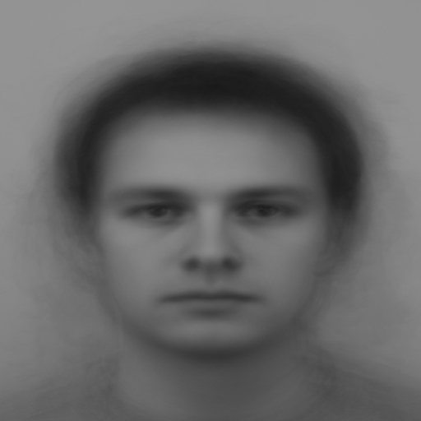
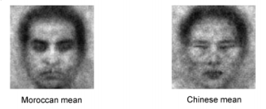
Reverse correlation image classification task is used to estimate internal representations of a target category
Politicians Ratner, Dotsch, Wigboldus, van Knippenberg, & Amodio, 2014
Dotsch & Todorov, 2012
Base face
Moroccon man
Chinese man
Romantic alternatives Karremans, Dotsch, & Coreille, 2011
Out-group members
Dotsch, Wigboldus, Langner, & van Knippenberg, 2008
Notes:
To start to answer these questions, we used a reverse correlation image classification task, which allows us to estimate internal representations of a target category.
Researchers have used this task to generate a wide variety of mental representations.

Slide 14
Image generation phase
Image rating phase
Create stimuli
pairs
Participants select from stimuli pairs
Create classification images from participant selections
New participants rate the classification image features
Notes:
A reverse correlation study typically has 2 general phases: an image generation phase in which we create pairs of stimuli that participants use to generate the target category. Then there’s a image rating phase where we create composites and give them to new participants to rate the facial features.

Slide 15
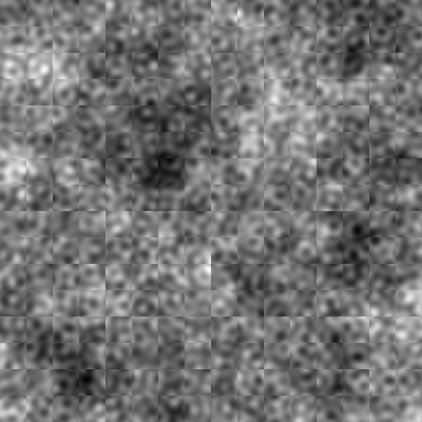
+/- Random noise mask
Base image
Average of all male faces in the Karolinska Face Database Lundqvist, Flykt, & Öhman, 1998
Notes:
In our study, every pair of stimuli is the product of a base image overlain with a random noise mask. This image is a grey scale composite of every male face in the Chicago Face Database.

Slide 16
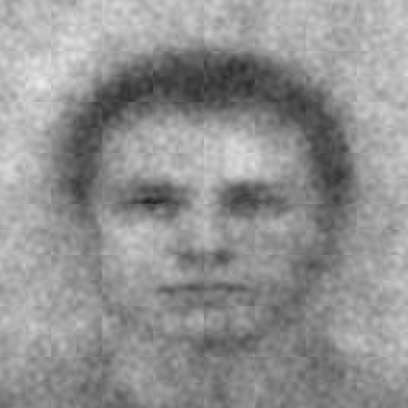
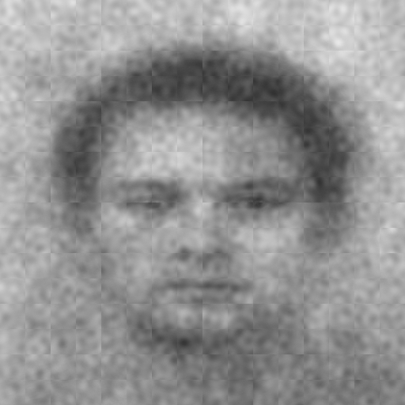
Which face looks more [insert category]?
Noise
added
Noise subtracted
400 face pairs
Notes:
Each face pair comprises the base face with the noise mask added and subtracted. On the left, noise is added and on the right noise is subtracted.

Slide 17
Study 1: Image generation phase
94 University of Michigan undergraduates
(80% power to detect r = .28)
Notes:
We recruited 94 students to complete the task and fill out some questionnaires.

Slide 18
Which face looks more germy?
Notes:
For our target category, we used germy.
During the task, participants selected one face from each pair that looked more germy.

Slide 19
Notes:
Every trial was followed by a fixation cross

Slide 20
400 trials
Notes:
And each participant completed 400 trials.

Slide 21
Trait-level pathogen concern (e.g. disgust, germ aversion) may increase sensitivity to infectious disease cues.
Tybur & Lieberman, 2016; Wang, Michalak, & Ackerman, In press
Notes:
We were also interested in how trait-level differences might affect people’s mental images. Past research suggests people vary in how sensitive they are to infectious disease cues

Slide 22
Trait-level physical harm concern may increase sensitivity to violence cues (e.g. anger).
e.g. Maner, Kenrick, Becker, et al., 2005
Notes:
As well as physical harm cues.

Slide 23
Trait-level threat concern measures
Pathogen concern
Physical harm concern
Perceived Vulnerability to Disease Questionnaire Duncan, Schaller, & Park, 2009
Germ Aversion
Perceived Infectability
Three Domain Disgust Scale Tybur, Lieberman, & Griskevicius, 2009
Belief in a Dangerous World Altemeyer, 1988
Notes:
So we measured a handful of trait-level threat concerns so that we could test threats against each other.
Germ Aversion measures affective responses to situations when pathogen transmission is likely (e.g. “It really bothers me when people sneeze without covering their mouths.”)
Perceived Infectability measures beliefs about susceptibility to disease and personal immune function (e.g. “In general, I am very susceptible to colds, flu and other infectious diseases.”)
Pathogen Disgust (e.g. “Sitting next to someone who has red sores on their arm”) measures motivations to avoid pathogens
Belief in a Dangerous World Scale measures chronic beliefs about danger in the world that affects safety (e.g. “There are many dangerous people in our society who will attack someone out of pure meanness, for no reason at all.”)

Slide 24
What does an infected person look like in people’s minds?
Notes:
To remind you of our first question, what does this person look like?

Slide 25
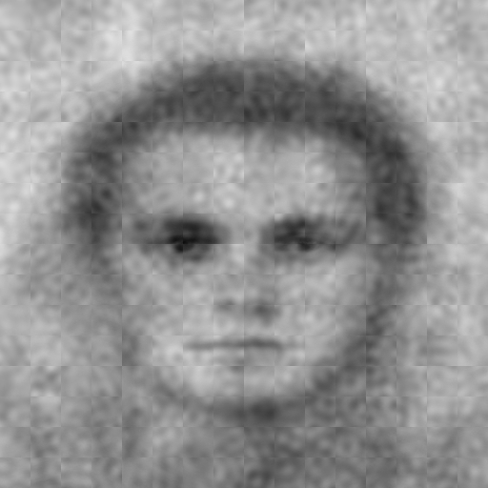
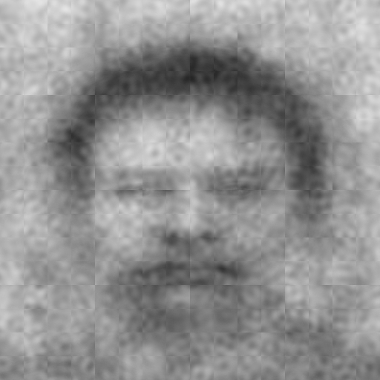
anti-Germy
Germy
Average of images not selected
Average of images selected
Generated using rcicr Dotsch, 2016
Michigan undergraduates (N = 94)
Notes:
Like I mentioned, we use participant choices to create two mental representations: on the right is our estimate of germy.
This is our estimate of what an infected person looks like in people's minds.
On the left is our estimate of not germy. It's also called the anti-classification image. This image is super important because it serves as our baseline image during our rating phase. In other words, we compare features of the germy image to features of the not germy image.

Slide 26
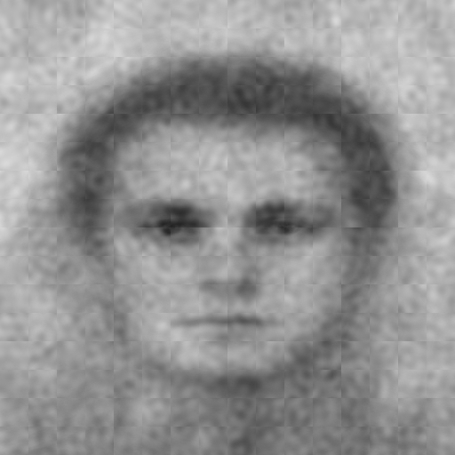
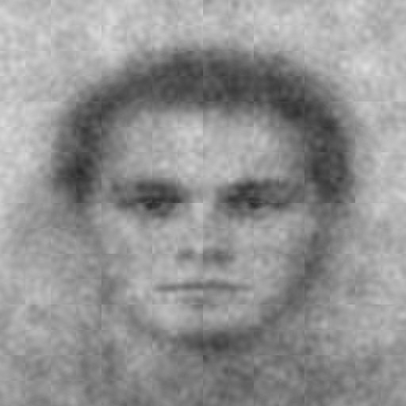
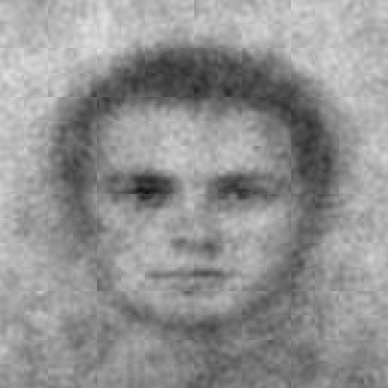
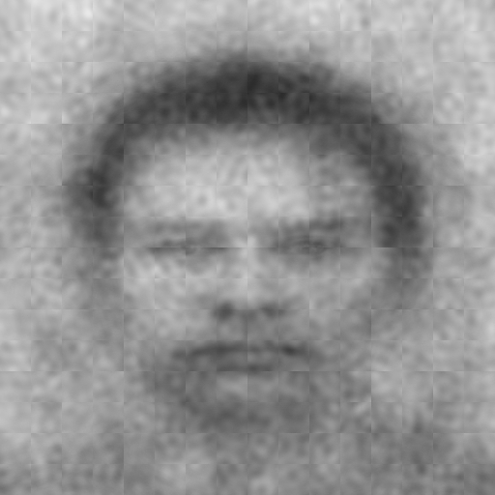
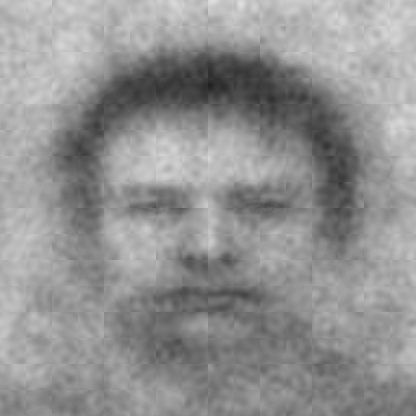
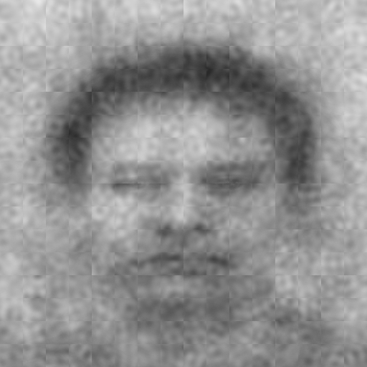
Germ Aversion subscale quantiles
n = 33
n = 33
n = 28
anti-Germy
Germy
[0-33%]
(33-66%]
(66-100%]
Also created images for Perceived Infectability
Notes:
To assess trait-level differences, we created both germy and anti-germy faces for 33% quantiles of germ aversion. From left to right are mental representations of a germy face for groups of people who score higher and higher on Germ Aversion.
So these are the same 94 people who made the images on the last slide, but we've grouped those people based on their Germ Aversion scores, and we made images based on those groups.

Slide 27
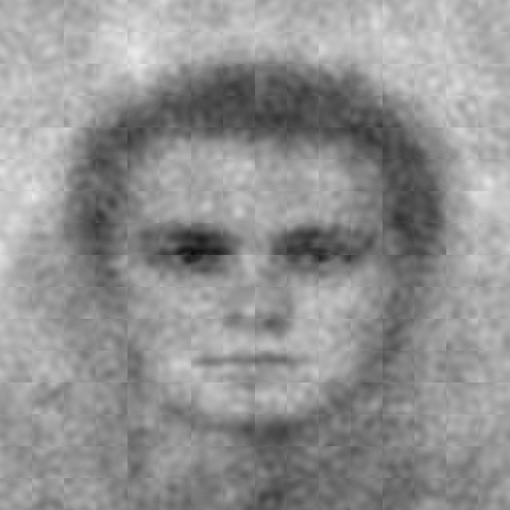
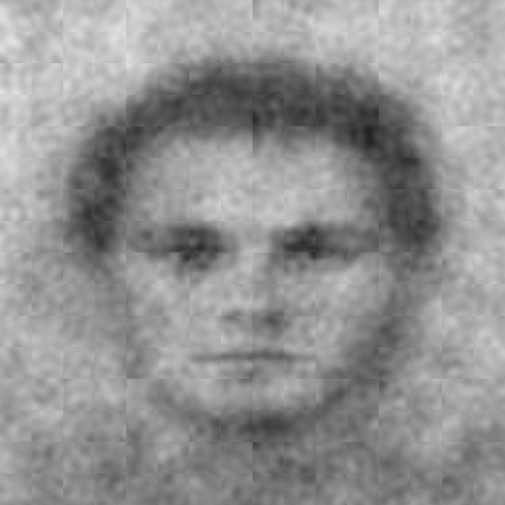
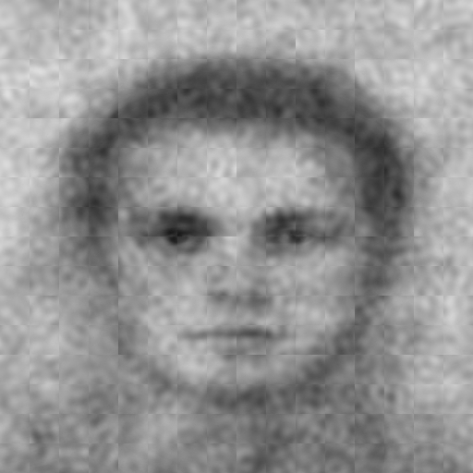
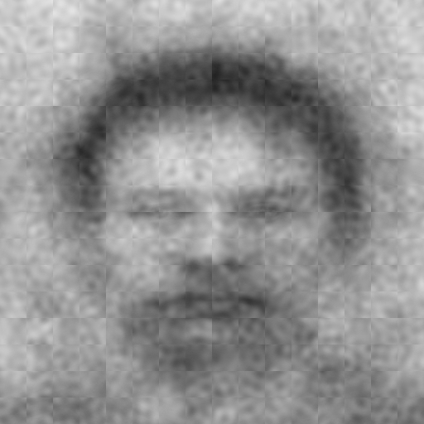
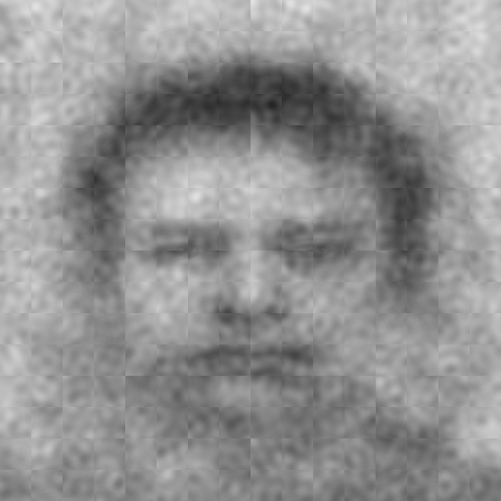
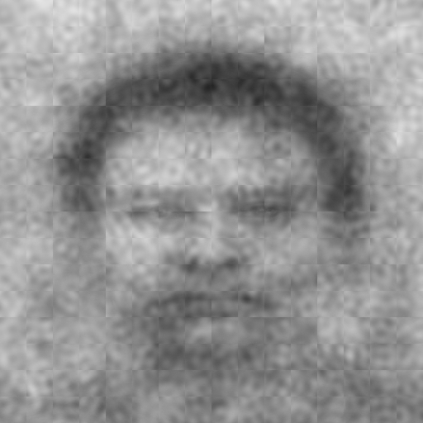
Belief in a Dangerous World quantiles
n = 34
n = 29
n = 31
anti-Germy
Germy
[0-33%]
(33-66%]
(66-100%]
Notes:
We did the same thing for belief in a dangerous world.
Again, calculated people's scores, we classified them into groups, and we created mental representations for each of those groups.

Slide 28
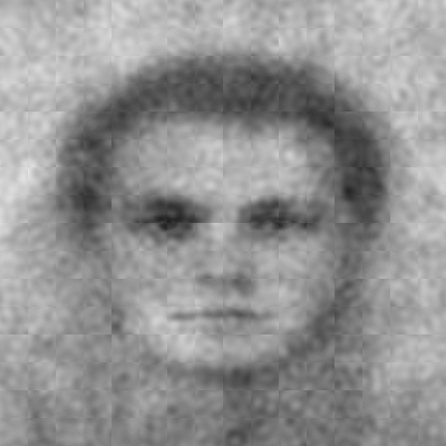
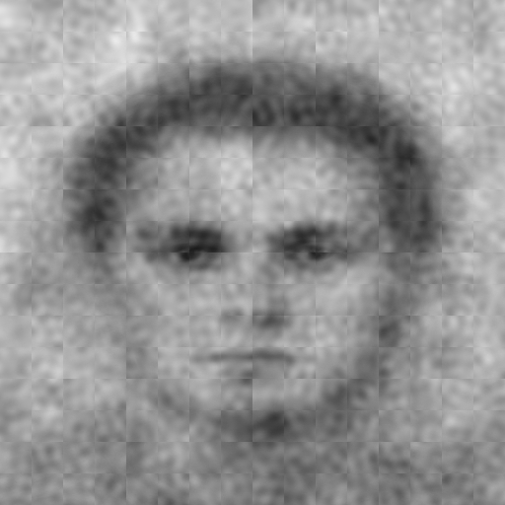
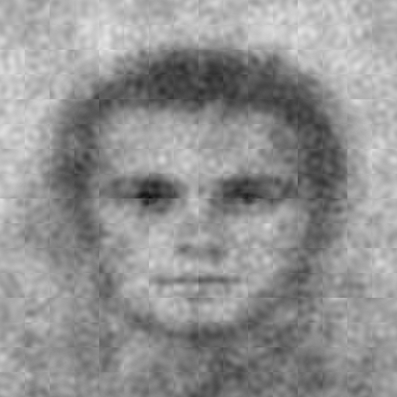
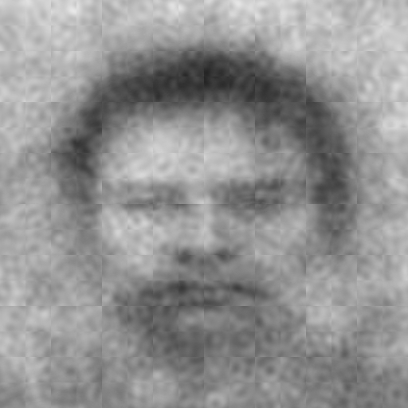
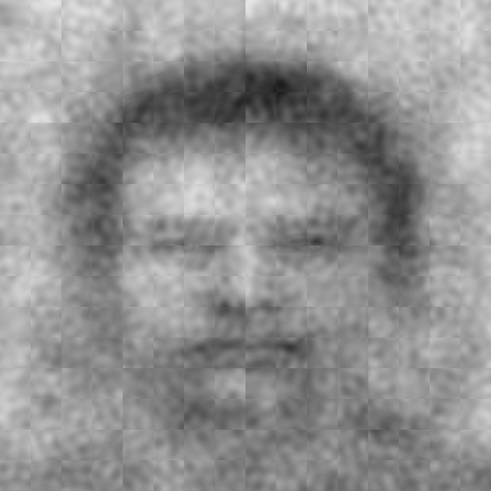
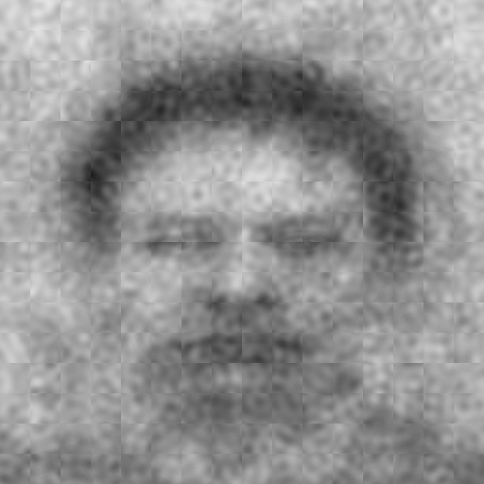
anti-Germy classification images
Germy classification images
Germ Aversion
(α = .73)
Perceived Infectability
(α = .92)
Belief in a Dangerous World
(α = .86)
Low
Moderate
High
Low
Moderate
High
Notes:
All in all, we created 20 images: 10 are germy images, and 10 are anti-Germy images.
The idea here is that there's an average mental representation and there are individual differences in mental representations.

Slide 29
Study 1: Image rating phase
269 MTurkers: 2 randomized conditions
(80% power to detect d = .34)
Pre-registered at aspredicted.org
TurkPrime Litman, Robinson, & Abberbock, 2016
Notes:
We pre-registered the experiment for MTurkers

Slide 30
Study 1: Image rating phase
Rated 10 anti-Germy images (n = 137)
Rated 10 Germy images (n = 132)
Pre-registered at aspredicted.org
TurkPrime Litman, Robinson, & Abberbock, 2016
Notes:
One group rated the Germy images and another rated the anti-Germy images.

Slide 31
Survey flow
Become familiar with image set
Read feature definitions
Rate each image by itself
Report intentions to avoid person in each image
Notes:
During the survey, first people ...

Slide 32
Features rated
More related to infectious disease
Less related to infectious disease
Germy
Disfigured
Heavy
Old
Foreign
Trustworthy
Violent
Arrogant
Incompetent
Not at all (0) to Extremely (8)
Notes:
Based on prior work on pathogen avoidance, we measured features that heuristically cue infectious disease: germy, disfigured, heavy, old, foreign, and trustworthy. We also measured features that are theoretically less relevant for infectious disease: violent, arrogant, and incompetent.
We predicted that the germy person would rated strongest on the features on the left and weakest on the features on the right.

Slide 33
Intentions to avoid
“If you were to meet in real life...”
“…how much would you want to avoid physical contact with this person?”
“...how willing would you be to stand near this person?” Reverse-scored
Not at all (0) to Extremely (8)
Notes:
We also measured behavioral intentions to avoid the germy person. At the end of the survey, we asked ...

Slide 34
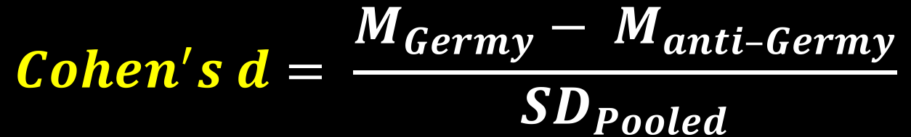
Dependent Variable on plots
$$Cohen^{′}s d= \frac{M_{Germy}− M_{anti–Germy}}{{SD}_{Pooled}}$$
Positive values = Stronger appearance for that feature (e.g. more germy looking)
Notes:
Just a quick note: the plot on the next slide depicts Cohen’s d effect sizes.
Larger, more positive values mean that germy face had a stronger appearance for that feature.

Slide 35
What does an infected person look like in the minds of participants? Generally negative? Does this person show heuristic cues to infection?
Notes:
Recall our first question, does this person have generally negative features and does this person show cues to infection?

Slide 36
Overall feature ratings
Germy
Disfigured
Old
Disease cues
Heavy
Foreign
Trustworthy
Violent
Incompetent
Arrogant
Avoid
Stand near
-1.25
-1.00
-0.75
-0.50
-0.25
0.00
0.25
0.50
0.75
1.00
1.25
Cohen's
d
95% confidence intervals
Notes:
Effect size is on the x-axis and features are on the Y axis. The germy image did show heuristic cues to infection: germy, disfigured, old, heavy, foreign, and untrustworthy.
The germy person was also rated more violent and incompetent, but the effects were smaller. Finally, people reported moderate intentions to avoid this germy person.

Slide 37
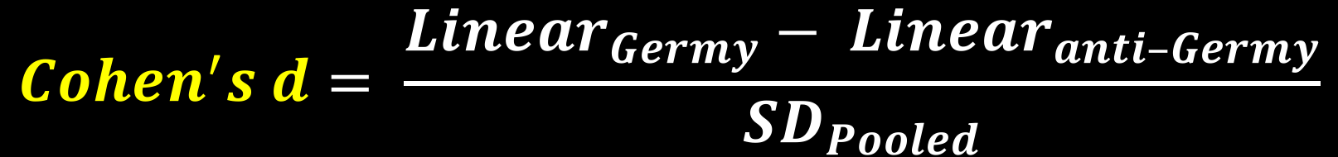
Dependent Variable on plots
-1
0
1
-1
0
1
$$Cohen^{′}s d= \frac{{Linear}_{Germy}− {Linear}_{anti–Germy}}{{SD}_{Pooled}}$$
Positive values = trait-level threat concern positively correlates with appearance for that feature
Notes:
The next plot is a little more complicated but not too much: here the effect captures the linear relationship between a given trait-level and feature rating.
Larger, more positive values mean that participants with higher trait-levels tended to generate mental images that were rated higher on a given feature.

Slide 38
Are these features more extreme for participants who feel more vulnerable to pathogen threats?
Notes:
Recall our question about trait-level differences.
Keep in mind we're trying to tap individual differences in how people represent an infected person.

Slide 39
Trait-level threat concern
Germ Aversion
Perceived Infectability
Belief in a Dangerous World
Germy
Disfigured
Old
Disease cues
Heavy
Foreign
Trustworthy
Violent
Incompetent
Arrogant
Avoid
Stand near
-1.0
-0.5
0.0
0.5
1.0
-1.0
-0.5
0.0
0.5
1.0
-1.0
-0.5
0.0
0.5
1.0
Cohen's
d
95% confidence intervals
Notes:
Each panel from left to right plots effects for the trait-level measures. I’ll walk you through a few panels at a time. We’ll start with germ aversion and perceived infectability. The trend is that people who were more germ averse and who perceived themselves to be more susceptible to disease tended to generate mental images that were rated as more germy, disfigured, old, heavy, foreign, and untrustworthy. They also tended to generate images that were rated as more violent, incompetent, and arrogant. When people reported intentions to avoid the people in these images, they reported intentions to avoid images that came from more pathogen concerned folks.
Now look at belief in a dangerous world: nearly all the confidence intervals capture zero and the patterns aren't consistent. This suggests that pathogen concern affects how people represent an infected person.

Slide 40
Do these images motivate people to avoid pathogen threats?
Notes:
Recall our question about avoidance

Slide 41
Mediator 1
Germy
Rating
b₁
a₁
Want to avoid
Germy = 1
anti-Germy = -1
c
Avoidance
c’
Willing to stand near
(reversed)
a₂
Latent DV
b₂
Disfigured
Rating
χ² = 2.765, df = 2, p = .251
RMSEA = .038, 90% CI [.000, .133], p = .460
TLI = .988
SRMR = .010
Mediator 2
Model fit with lavaan Rosseel, 2012
Notes:
We wanted to know whether infectious disease cues mediated avoidant intentions.
Specifically, we predicted that germy images would be rated more germy and more disfigured, and these ratings would mediate intentions to avoid. Our model fit the data well.

Slide 42
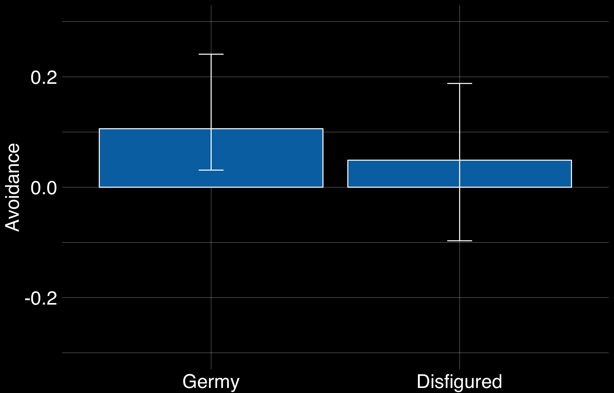
Indirect effects
95% confidence intervals
Notes:
Most importantly, both indirect effects were positive, but only germy was significant. However, both effects are consistent with our hypothesis that infectious disease cues mediate avoidant intentions.

Slide 43
Study 1: take this with you
Infected person looks germy, disfigured, heavy, old, foreign, violent, and incompetent
People who are more worried about disease exaggerate these features in their mental representation
Germy and disfigured appearance mediates intentions to avoid
Notes:
From study 1, remember that the infected person ...

Slide 44
Study 2: Goals
Replicate germy mental image
Contrast germy mental image with another threat: violence
Measure more features
Research question: Do both mental representations cue the same threats?
Notes:
We had three goals for study 2: first ...
We wanted to replicate the germy representation and contrast it with a violent representation.
We wanted to test whether both mental representations would show the same cues and suggest the same threats.

Slide 45
Study 2: Image generation phase
200 MTurkers: 2 randomized conditions
(80% power to detect r = .20)
Pre-registered at aspredicted.org
TurkPrime Litman, Robinson, & Abberbock, 2016
Notes:
This time we used MTurkers

Slide 46
Study 2: Image generation phase
Picked the more Germy face (n = 98)
Picked the more Violent face (n = 102)
Pre-registered at aspredicted.org
TurkPrime Litman, Robinson, & Abberbock, 2016
Notes:
We randomly assigned ...

Slide 47
Survey flow
Read target category definition
Completed one practice trial
Completed reverse correlation task
Completed trait-level measures
Notes:
During the study, this time we gave them definitions and a practice trial. The, like in study 1 ...

Slide 48
Target category definitions
“Use the definition of germy / violent below when making your decisions.”
germy: full of germs; germ infested; appearing either sick or contaminated
violent: prone to commit acts of violence; uses physical force intended to hurt, damage, or kill someone or something
Notes:
Here are the definitions. They only saw one.

Slide 49
Trait-level threat concern measures
Pathogen threat concern
Physical harm concern
Perceived Vulnerability to Disease Questionnaire Duncan, Schaller, & Park, 2009
Germ Aversion
Perceived Infectability
Self-Protection subscale (α = .91) Neel, Kenrick, White, & Neuberg, 2015
Notes:
Like in study 1...
but instead of belief in a dangerous world, we used a more direct measure of physical harm concern.

Slide 50
Goal #1: Replicate germy mental representation

Slide 51
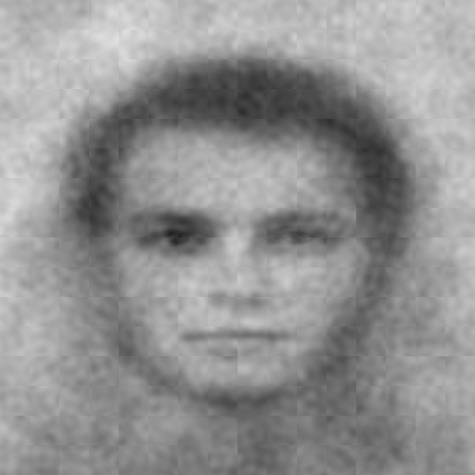
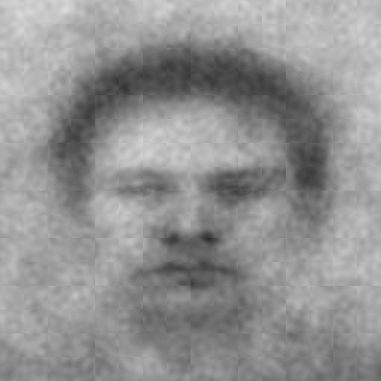
anti-CI
CI
Study 1
N = 94
Germy
(U of M)
Study 2
N = 102
Germy
(MTurk)
Generated using rcicr Dotsch, 2016
Notes:
Here are the mental images from study 1 and 2. As you can see, they're pretty similar.

Slide 52
Goal #2: Contrast germy and violent mental representations

Slide 53
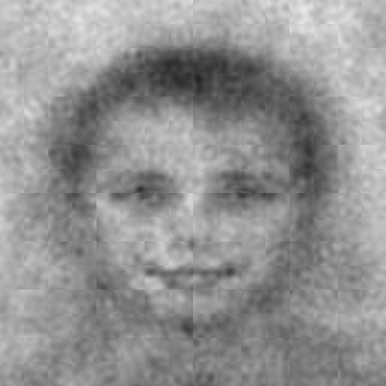
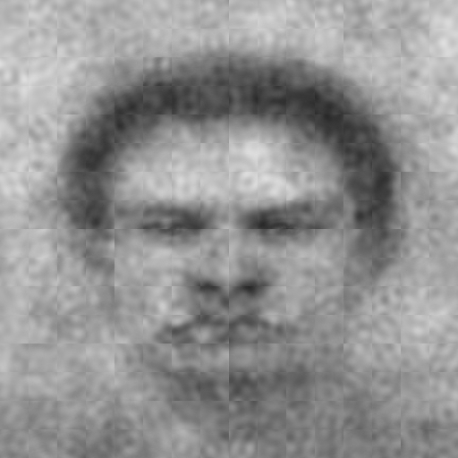
anti-CI
CI
Violent
n = 98
Germy
n = 102
Generated using rcicr Dotsch, 2016
Notes:
Here are both average images from study 2. Take a second to look at how different the violent image is.
Germy and violent represent distinct fundamental threats and these threats seem to emerge in people's mental images.

Slide 54
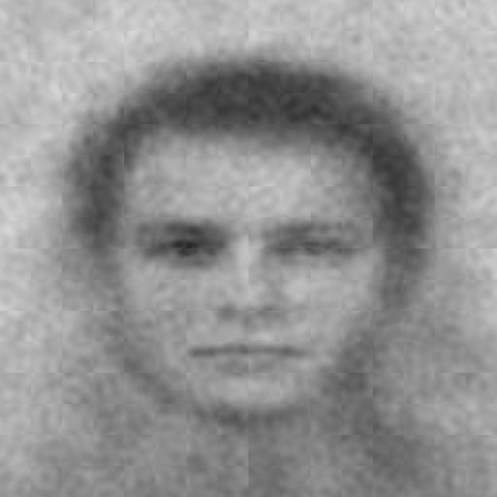
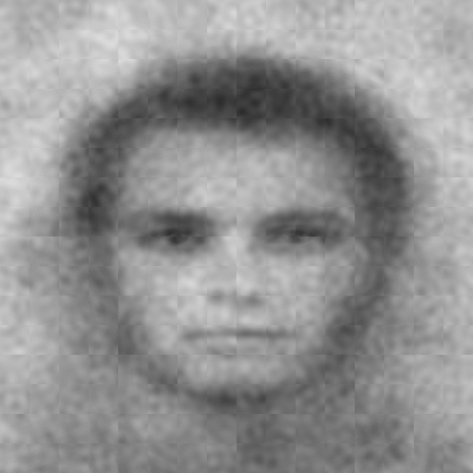
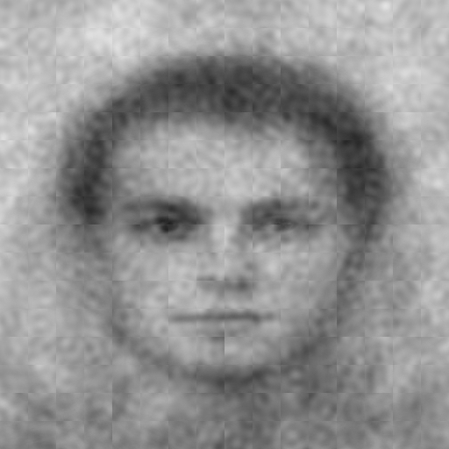
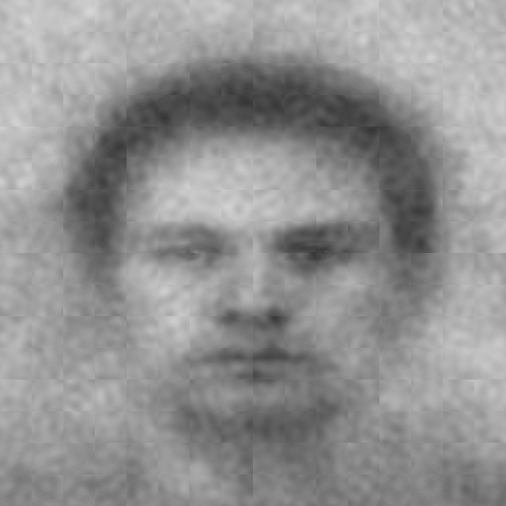
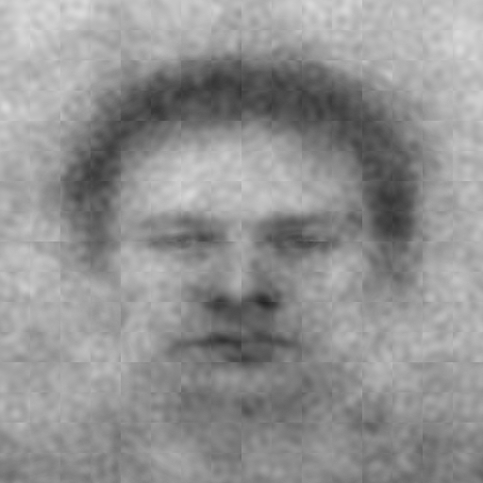
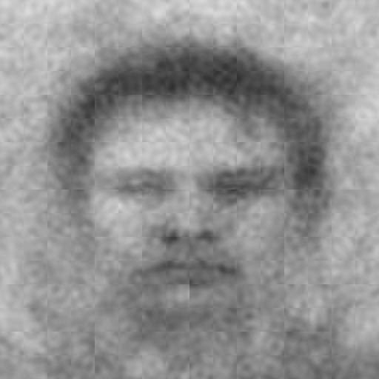
Perceived Infectability subscale quantiles
n = 33
n = 36
n = 29
anti-Germy
Germy
[0-33%]
(33-66%]
(66-100%]
Also created images for Germ Aversion and Self-Protection
Notes:
Like before, we created groups of people based on their trait-level scores. From left to right you can see germy mental images from people who score higher and higher of perceived infectability.

Slide 55
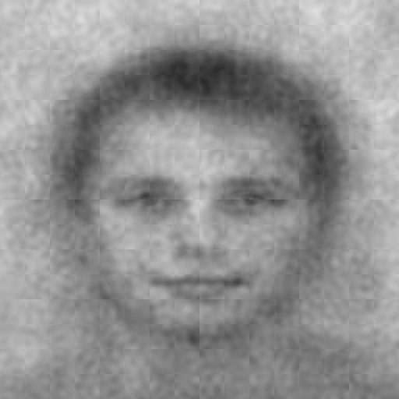
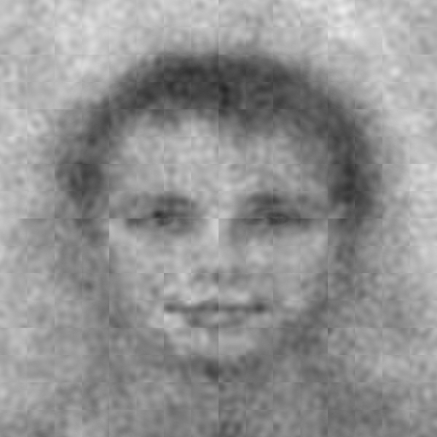
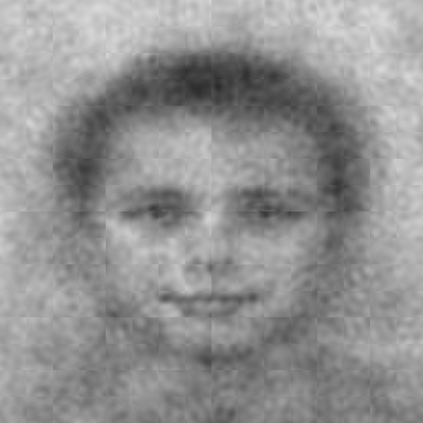
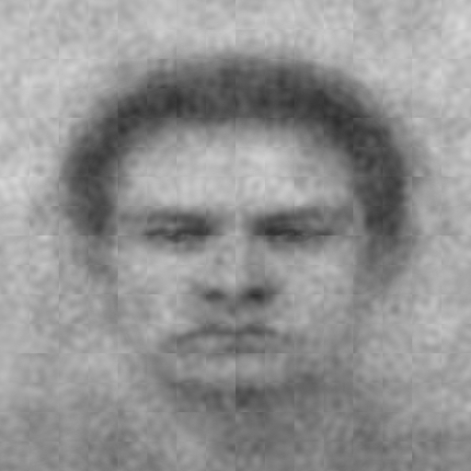
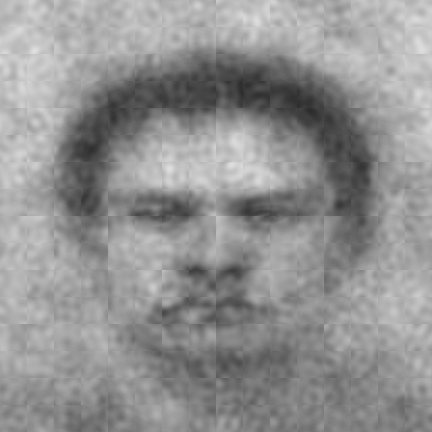
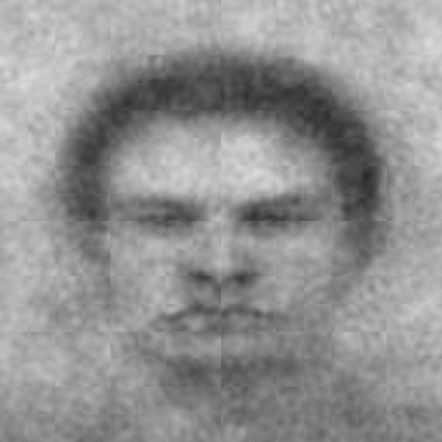
Perceived Infectability subscale quantiles
n = 38
n = 26
n = 36
anti-Violent
Violent
[0-33%]
(33-66%]
(66-100%]
Also created images for Germ Aversion and Self-Protection
Notes:
we also created violent images who people who scored higher and higher on perceived infectability.

Slide 56
Average | Germy |  |  | anti-Germy |  |  | Violent |  |  | anti-Violent
Germ Aversion | Low | Moderate | High | Low | Moderate | High | Low | Moderate | High | Low | Moderate | High
Perceived Infectability | Low | Moderate | High | Low | Moderate | High | Low | Moderate | High | Low | Moderate | High
Self-Protection | Low | Moderate | High | Low | Moderate | High | Low | Moderate | High | Low | Moderate | High
40 classification images
Notes:
all in all, we created 40 classification images
Again, the idea is to test both average mental images as well individual differences in mental images

Slide 57
Study 2: Image rating phase
507 MTurkers: 4 randomized conditions
(80% power to detect d = .25)
Pre-registered at aspredicted.org
TurkPrime Litman, Robinson, & Abberbock, 2016
Notes:
we recruited MTurkers ...

Slide 58
Study 2: Image rating phase
Rated 10 anti-Germy images (n = 126)
Rated 10 Germy images (n = 127)
Rated 10 anti-Violent images (n = 126)
Rated 10 Violent images (n = 128)
Pre-registered at aspredicted.org
TurkPrime Litman, Robinson, & Abberbock, 2016
Notes:
like in study 1, ...

Slide 59
Features rated
More related to infectious disease
Less related to infectious disease
Disfigured
Germy
Heavy
Old
Foreign
Nauseous
Violent
Dominant
Muscular
Masculine
Incompetent
Angry
Not at all (0) to Extremely (8)
Notes:
Like in study 1 ...
But we also measured traits we expected to be more related to physical harm threat ...

Slide 60
Intentions to avoid
“If you were to meet in real life...”
“…how much would you want to avoid physical contact with this person?”
“...how willing would you be to stand near this person?” Reverse-scored
Not at all (0) to Extremely (8)
Notes:
like in study 1 ...

Slide 61
Research question: Do both mental representations cue the same threats?
Notes:
recall our question ...

Slide 62
Overall feature ratings
Target Category
Germy
Violent
Germy
Nauseous
Disease cues
Disfigured
Heavy
Old
Foreign
Incompetent
Violent
Physical harm cues
Angry
Muscular
Masculine
Dominant
Avoid
Stand near
-2.0
-1.5
-1.0
-0.5
0.0
0.5
1.0
1.5
2.0
Cohen's
d
95% confidence intervals
Notes:
replicating study 1, the germy image appeared more germy, disfigured, heavy, old, and foreign; it also appeared more incompetent, more violent, and more angry. However, it only appeared weakly more muscular, more masculine, and more dominant. Also, as in study 1, people reported wanting to avoid the germy representation.
Surprisingly, the violent representation also showed all of infectious disease cues. However, the violent representation appeared extremely angry, violent, and dominant--way more so than the germy representation. As you might expect, people reported wanting to avoid the violent representation.

Slide 63
Are these features more extreme for participants who feel more vulnerable to pathogen threats?
Notes:
Back to our second question ...

Slide 64
Trait-level threat concern
Target Category
Germy
Violent
Germ Aversion
Perceived Infectability
Self-Protection
Germy
Nauseous
Disfigured
Disease cues
Heavy
Old
Foreign
Incompetent
Violent
Physical harm cues
Angry
Muscular
Masculine
Dominant
Avoid
Stand near
-1.0
-0.5
0.0
0.5
1.0
-1.0
-0.5
0.0
0.5
1.0
-1.0
-0.5
0.0
0.5
1.0
Cohen's
d
95% confidence intervals
Notes:
surprisingly, perceived infectability more strongly correlated with how MTurkers imagined a germy person.
like germ aversion in study 1, in study 2, people who scored higher on perceived infectability tended to imagine germy people with a lot of negative facial features, and people wanted to avoid the germy person these participants imagined
also like in study 1, physical harm threat did not seem to explain variability in mental image features: the trends tend to bounce around without suggesting much of a pattern, at least to my eye
regarding the violent images, we found some evidence to suggest that both germ aversion and perceived infectability correlate with their facial features, but in many cases these correlations are weaker compared to correlations with the germy image features.
like with the germy images, self-protection correlations with facial feature ratings don't follow a consistent pattern

Slide 65
Do these images motivate people to avoid pathogen threats?
Notes:
We can also look at these features and how they affect intentions to avoid.

Slide 66
Germy
Nauseous
Disfigured
CI type x target category
Mediator 1
Infection cues
Want to avoid
anti-CI = -1
CI = 1
Avoidance
Willing to stand near
(reversed)
Physical harm cues
Latent DV
Mediator 2
Germy = -1
Violent = 1
χ² = 88.873, df = 36, p < .001; RMSEA = .054, 90% CI [.040, .068], p = .309; TLI = .964; SRMR = .026
Moderator
Violent
Angry
Dominant
Model fit with lavaan Rosseel, 2012
Notes:
We expect these threat cues to mediate avoidance, but the strength of mediation depends on the mental image.
In other words, people probably want to avoid infected people and violent people, but they avoid these people for different reasons, depending on the strongest perceivable cues.

Slide 67
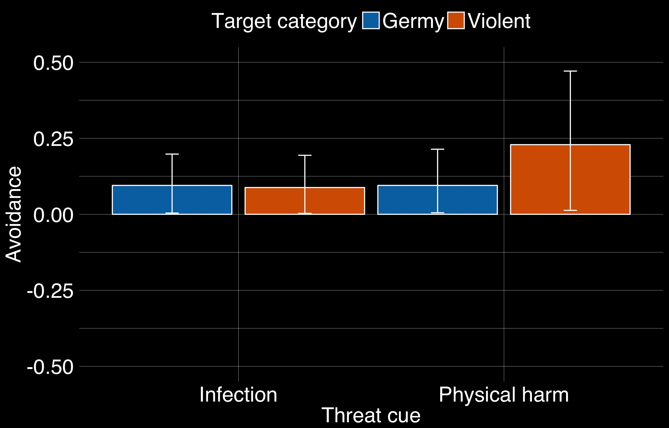
Indirect effects
95% confidence intervals
Notes:
We found evidence that people want to avoid the germy and violent person because they look infected and because they might hurt them, but people really wanted to avoid the violent person because he looked so violent, angry, and dominant.

Slide 68
Study 2: take this with you
Infected person looks germy, nauseous, disfigured, heavy, old, incompetent, angry, and violent
People who are more worried about disease exaggerate these features in their mental representation
Infectious disease + physical harm cues mediate intentions to avoid

Slide 69
anti-CI
CI
Germy
(UM)
Germy
(MTurk)
Notes:
Remember the germy mental representations from both studies. Take a second to think about what you had expected an infected person to look like. By in large, these images do seem to show many of the features associated with infectious disease through the literature. This isn’t to say we weren’t surprised by what they looked like and how they were rated, especially compared to the violent images.

Slide 70
Some surprises
Notes:
We saw quite a bit of overlap between the germy and the violent mental representation.

Slide 71
Some surprises
Negative halo effects Kurzban & Leary, 2001; Zebrowitz, Fellous, Mignault, & Andreoletti, 2003
Strongest halo effects for violent image, not the germy image
Physical harm concern didn’t seem to exaggerate features in either mental image
Notes:
We expected specificity but this data is consistent with overgeneralization and negative halo effects.
However, we saw the strongest halo effects for the violent representations.
And physical harm concern didn't seem to exaggerate any of the facial features.
This may be due to ceiling effects in how people represent violent people or the reverse correlation task may just not let harm sensitive people express the features they think about

Slide 72
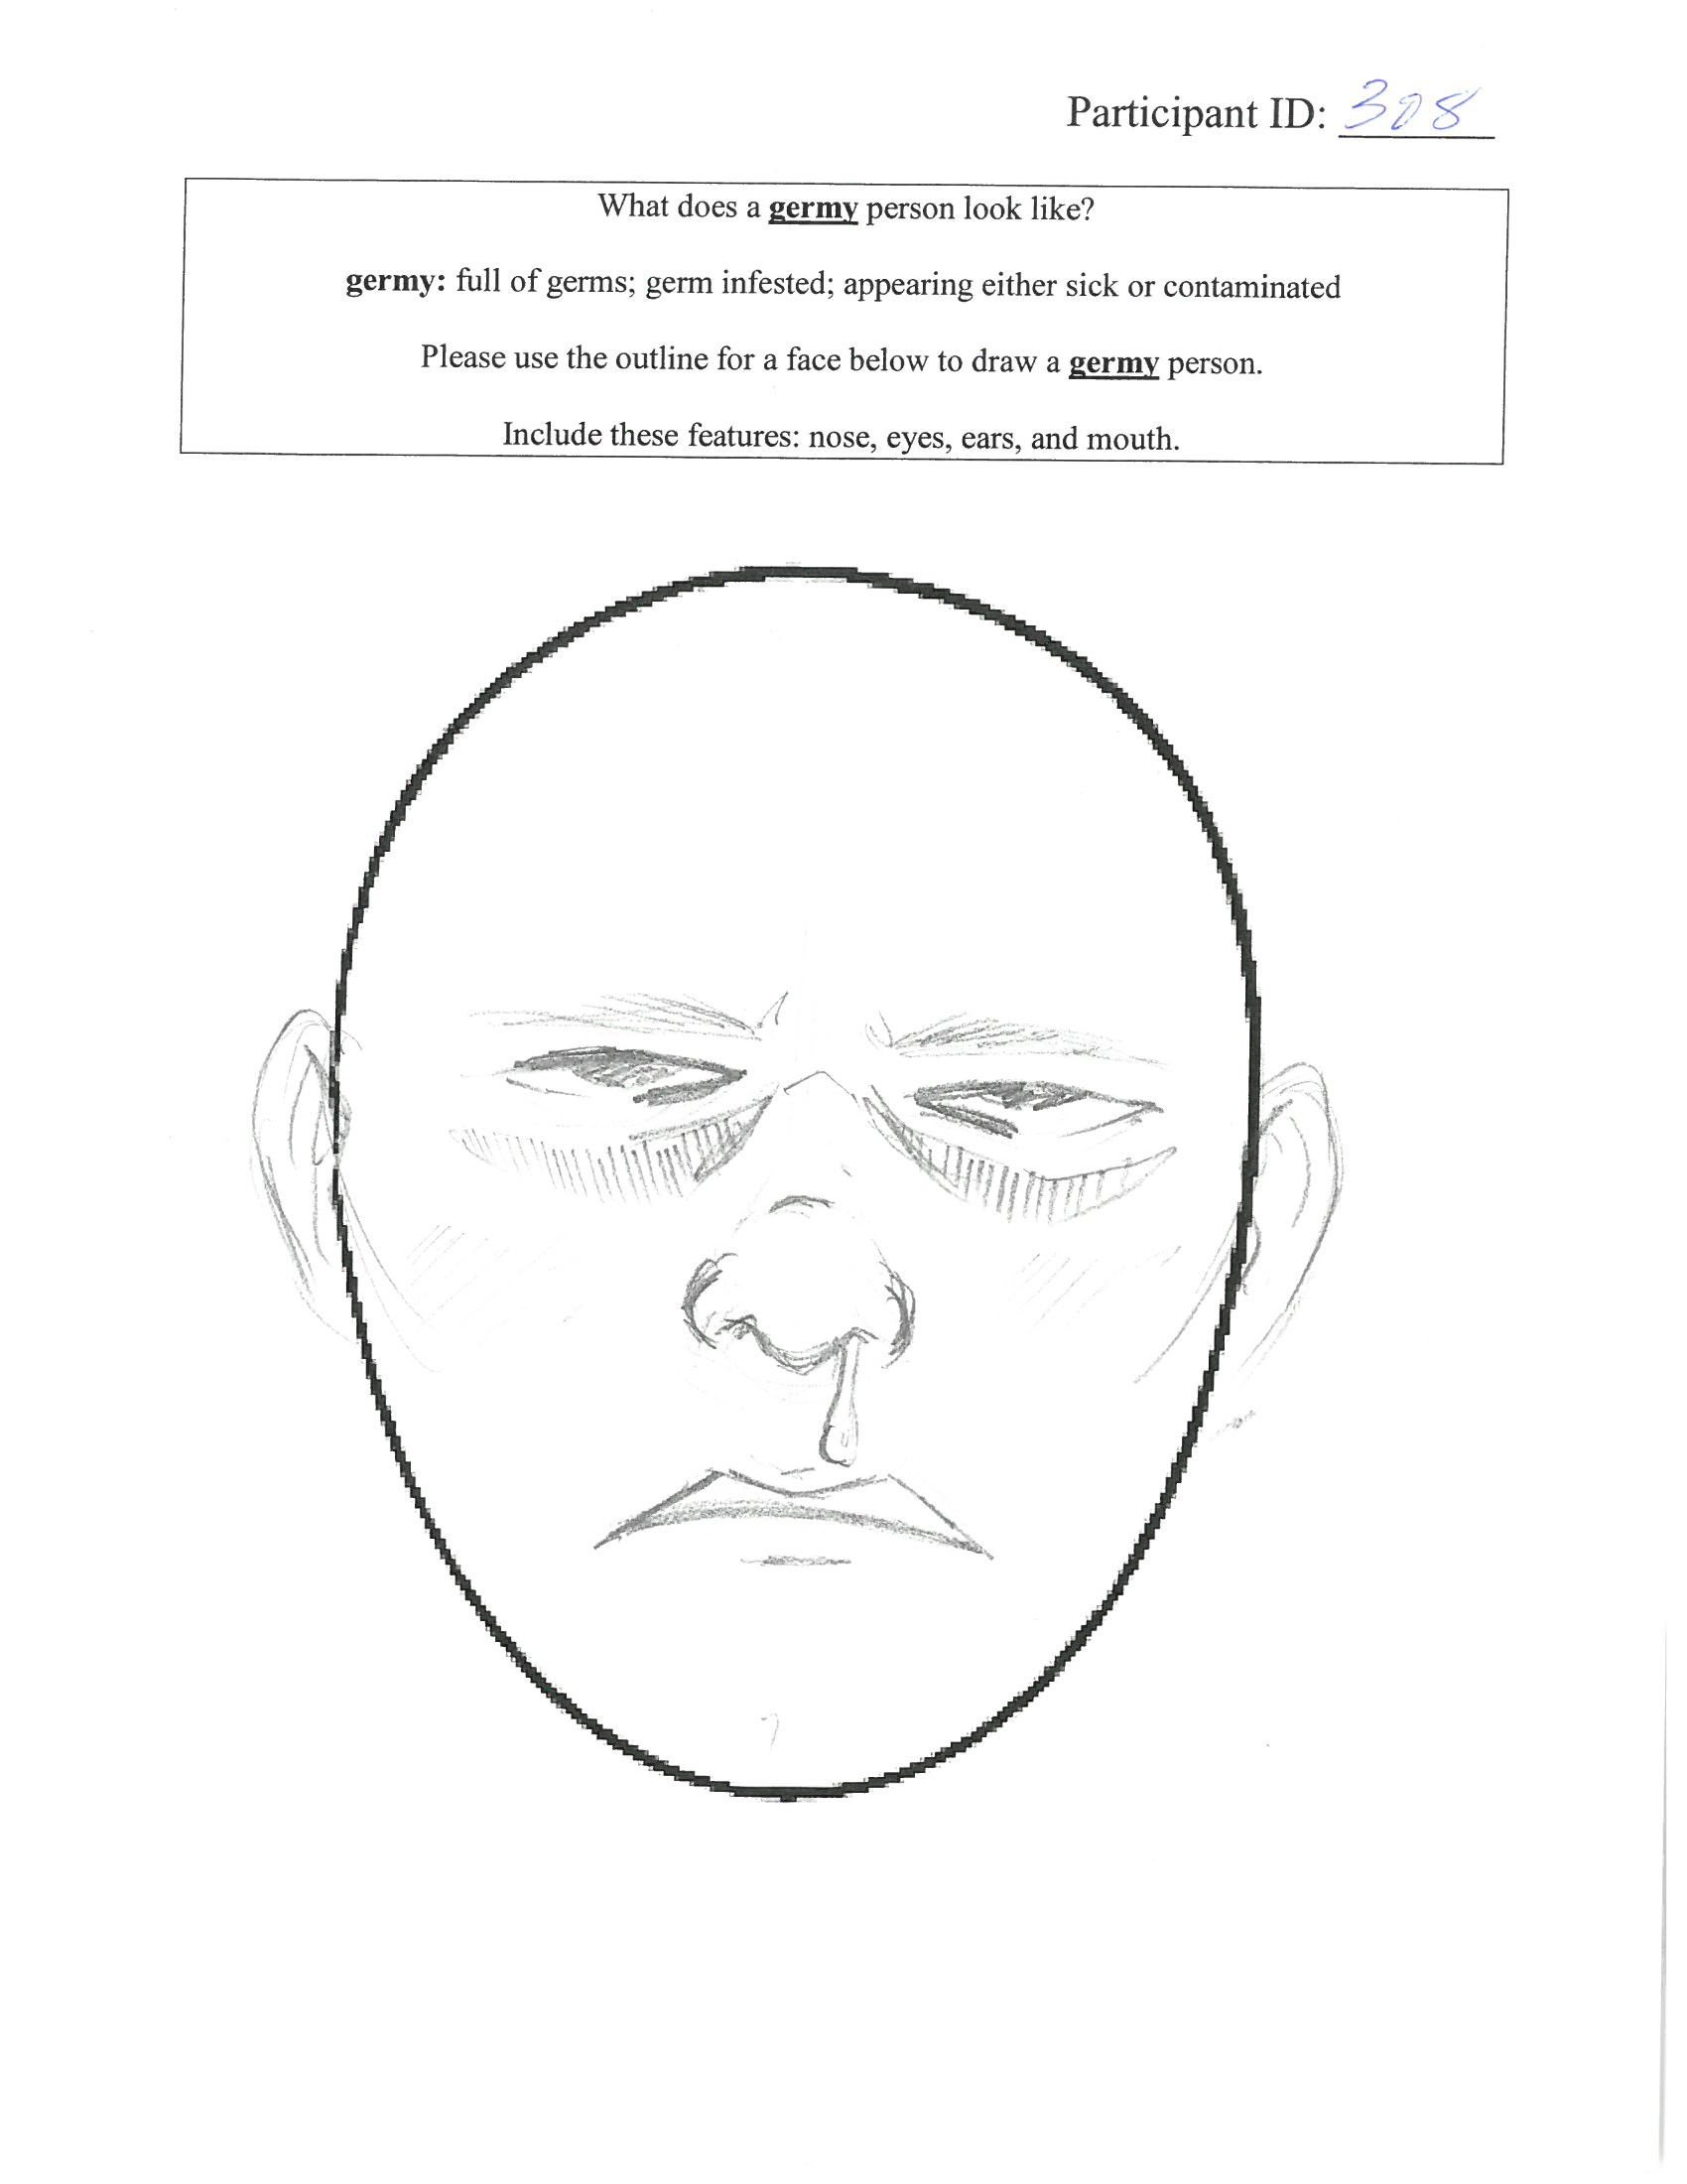
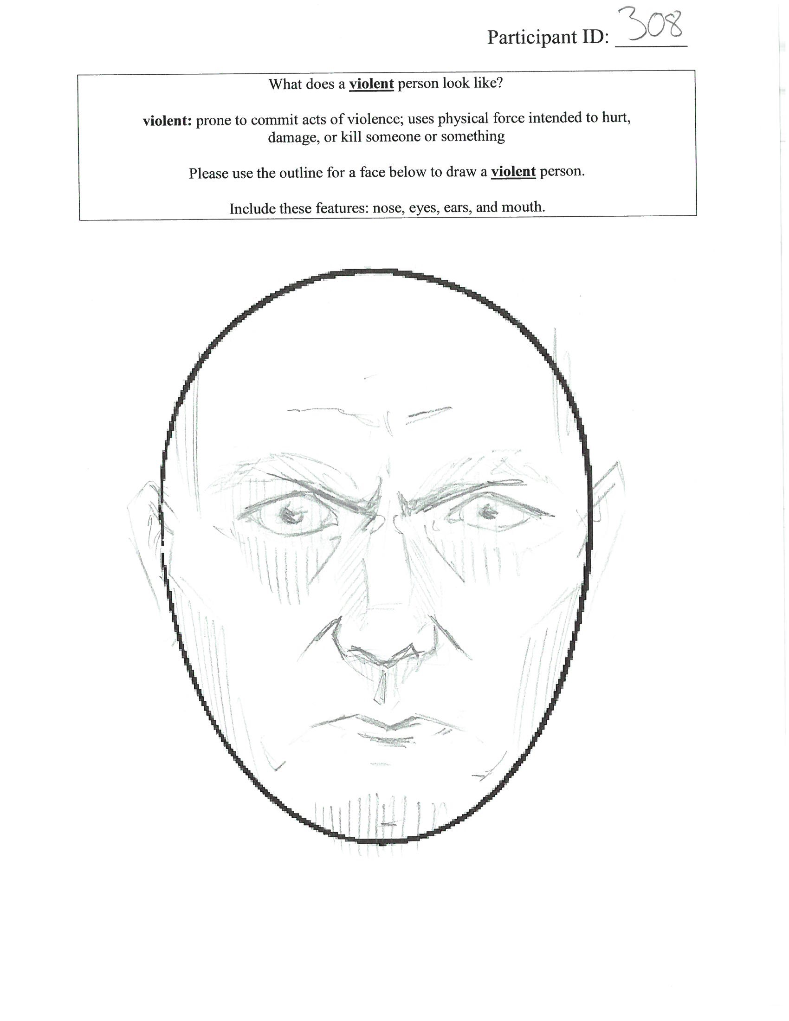
Follow up studies: drawings
Germy
Violent
Notes:
In the same vein, one clear limitation of the reverse correlation task is that it doesn't allow for some facial details that are obviously relevant for infectious disease like lesions and runny noses and blood-shot eyes. We’re currently coding over 300 drawings of germy and violent phases.
We're also conducting some more ratings studies to test for specificity in facial features.

Slide 73
Evolutionary Social Psychology Lab
Lab
Josh Ackerman, PhD
Iris Wang
Oliver Sng, PhD
Yuching Lin
Reseach assistants
Emily Jones
Isabel Osgood
Tyler Aman
Megan Mulhinch
Emily Dyke
Shyryn Borgol
Michelle Conklin
Amanda Yoo
Download these slides @ OSF Nicholas Michalak https://osf.io/gb5xj/
Notes:
Shout out to the evolutionary social psychology lab at Michigan. As a side, you can find my slides at the open science framework.

Slide 74
Thank you
nickmm@umich.edu
Notes:
Thank you

Slide 75
Study 1 Feature definitions
old: advanced physical age; featuring signs of having lived for a long time; no longer young in appearance
germy: full of germs; germ infested; appearing either sick or contaminated
heavy: large physical weight; having excess flesh; wide or thick with fat (not muscle), appearing to weigh more than the average person
disfigured: problematic or damaged physical appearance; blemished; deformed; impaired (as in beauty) by deep and persistent injuries or developmental problems
foreign: strange or unfamiliar; not native; belonging to a group that is not your own
violent: prone to commit acts of violence; uses physical force intended to hurt, damage, or kill someone or something
arrogant: having or revealing an exaggerated sense of one's importance or abilities; showing an offensive sense of superiority; behaving as if better or more important than other people
incompetent: not having or showing the necessary skills to do something successfully or properly; unskilled
trustworthy: dependable; able to be relied on to do or provide what is needed or right; deserving of trust; worthy of confidence

Slide 77
Study 2 Feature definitions
old: advanced physical age; featuring signs of having lived for a long time; no longer young in appearance
heavy: large physical weight; having excess flesh; wide or thick with fat (not muscle), appearing to weigh more than the average person
disfigured: problematic or damaged physical appearance; blemished; deformed; impaired (as in beauty) by deep and persistent injuries or developmental problems
foreign: strange or unfamiliar; not native; belonging to a group that is not your own
muscular: having well-developed muscles; brawny; physically strong
masculine: pertaining to or characteristic of a man or men; possessing qualities typically associated with men
violent: prone to commit acts of violence; uses physical force intended to hurt, damage, or kill someone or something
germy: full of germs; germ infested; appearing either sick or contaminated
dominant: physically or forcefully commanding and controlling; able to gain power over others through threat and intimidation
incompetent: not having or showing the necessary skills to do something successfully or properly; unskilled
angry: having a strong feeling of or showing annoyance, displeasure, or hostility; full of anger
nauseous: affected with nausea; inclined to vomit; sick, queasy, or disgusted

